Slide 1
Variables
Tutorial #5

Slide 2
OBJECTIVE

Slide 3
Objective
This tutorial will show you how to control the flow of information throughout your program.

Slide 4
TEXTPLANATION

Slide 5
Textplanation
You know what a variable is, right? Your equation has and x in it and you can figure out the value of x based on the rest of the equation. Simple, right? In computer programming, you, as the programmer, don’t ever have to figure out what the value of your variable is.

Slide 6
Textplanation
Okay, that’s a lie.

Slide 7
Textplanation
When you’re debugging, you often times need to figure out the values of your variables in order to see if things are working properly.

Slide 8
Textplanation
But, during coding, you don’t need to know. When you make a variable, you are creating an object (there’s that word again) that represents something. It can represent the number of bananas in a bunch or the name of your favorite stuffed toy or the bird that just landed on the fence outside. The reason it’s a variable is because its value can change. If there are 6 bananas in the bunch and I take one and eat it, that means there are now only 5 bananas in the bunch. The variable still represents the same thing, but the value has changed.

Slide 9
Textplanation
This concept of variable vs. value is extremely important. When you write a computer program, you need to figure out what pieces of information you’ll need to keep track of during its execution. Whatever you decide you need, you make a variable for. If you’re in the middle of the program and realize that you need to keep track of some unforeseen piece of information, you can make a variable for that, too.

Slide 10
Textplanation
There are essentially 4 types of variables.
Numbers
Numbers can be broken down into integers and floating point decimal numbers.
Booleans
A boolean can only have a value of true or false. Don’t be fooled, though. Booleans are powerful and essential in programming.
Strings
A string is a series of characters strung together to form a single value. These characters can be just about anything, but are commonly made from the letters, numbers, and the symbols that appear on your keyboard.
Objects
Isn’t everything an object? You bet your life it is, but memory differentiates between primitive variables, like the three mentioned previously, and complex objects, like the bird that landed on my fence.

Slide 11
CONSTRUCTION

Slide 12
Construction
Create a folder somewhere on your drive and label it ASMD (for Add, Subtract, Multiply, Divide).
Open up notepad++.
Save the empty file to your folder and name the file “index.html”.
All first pages on a website are called index.
As you go through the images of the construction, add to your code. You will see comments with explanations of what you are doing. Those comments will change with each slide. You should not type my comments into your code.

Slide 13
Construction
This program is going to take 2 numbers, perform an arithmetic operation on them, and then alert the result.

Slide 14
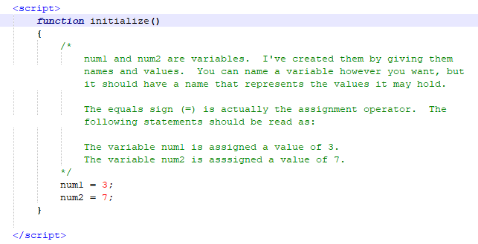
Construction

Slide 15
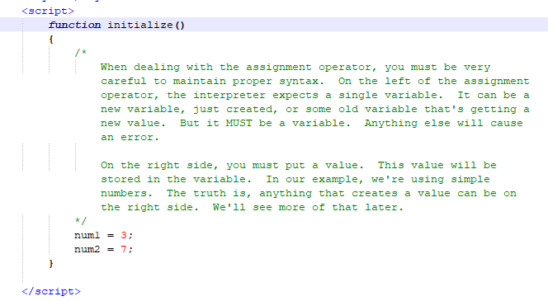
Construction

Slide 16
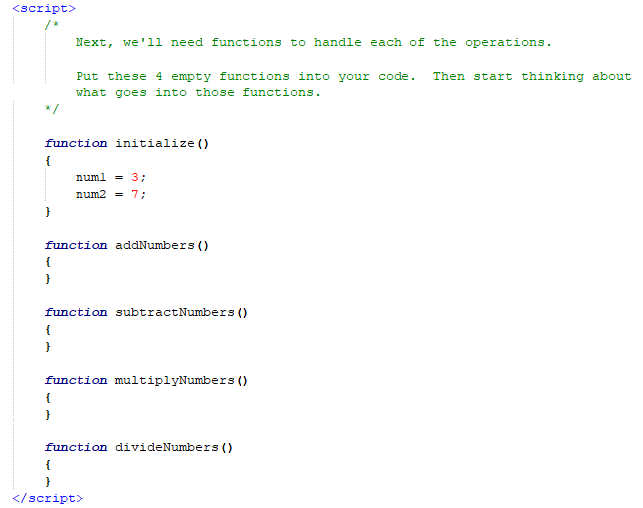
Construction

Slide 17
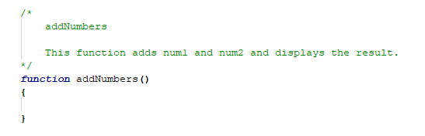
Construction

Slide 18
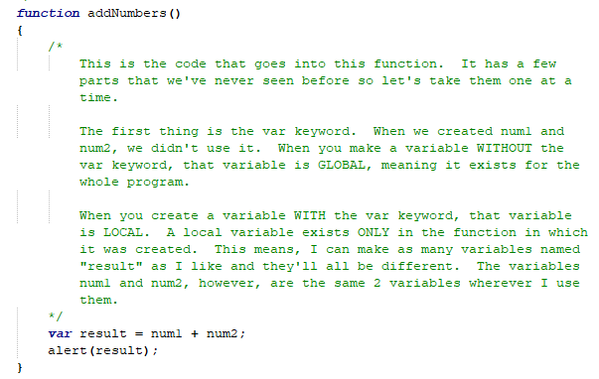
Construction

Slide 19
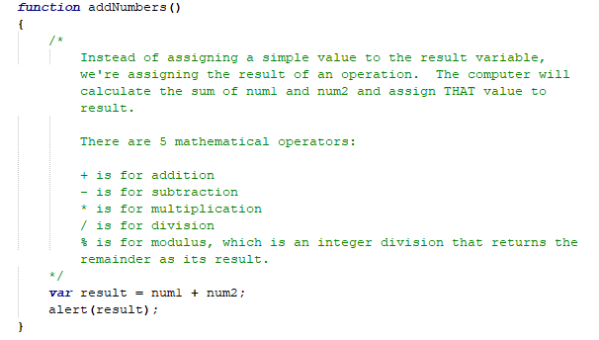
Construction

Slide 20
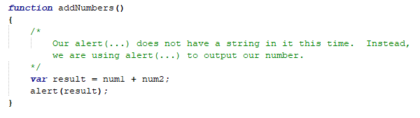
Construction

Slide 21
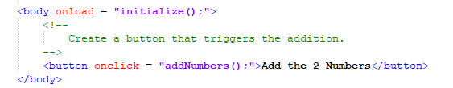
Construction

Slide 22
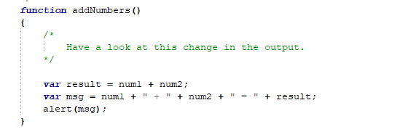
Construction

Slide 23
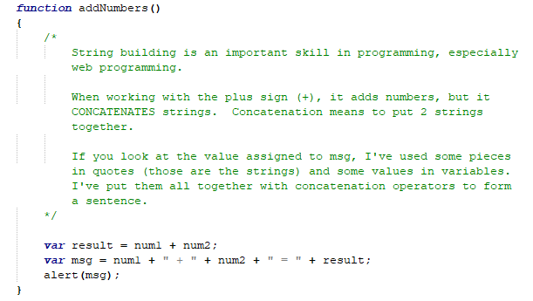
Construction

Slide 24
A DEEPER MEANING

Slide 25
A Deeper Meaning
Think of a variable as an empty box. The value is what you put inside of the box. The box is only big enough for one value so, if you put a new value into the box, the old one is removed and thrown away. In applications languages, variables need to be more streamlined. You have to tell it what type of information is going into it before filling it. If you put the wrong kind of information inside, you’ll get an error. In scripting languages, variables take on a one-size-fits-all approach. That means you can put any value into any variable. That doesn’t mean variable types don’t exist. It means they’re fluid.

Slide 26
A Deeper Meaning
I can put a number into my variable x and later decide to put a string in there. I don’t have to ask permission from anyone nor is there any kind of overhead. It just happens because I made it happen. That doesn’t mean this is a good thing to do. It just means you can do it.

Slide 27
A Deeper Meaning
Scripting languages are filled with all kinds of things that you can do, but shouldn’t.

Slide 28
A Deeper Meaning
When you create a variable, you absolutely need to think about that variable in terms of what it represents, rather than what value is going to be in there. This is pretty easy when it comes to a bunch of bananas. My variable, bananaBunch, represents a the number of bananas in a bunch. Well, when the code is executing, how many bananas are in the bunch?

Slide 29
A Deeper Meaning
I don’t know.

Slide 30
A Deeper Meaning
And, more importantly, I don’t care.

Slide 31
A Deeper Meaning
As long as I know what that variable represents, its value is irrelevant to me as the programmer.

Slide 32
FAQ

Slide 33
FAQ
Question?
Answer.

Slide 34
ACTIVITY

Slide 35
ASMD
Our ASMD only covers the A (add) part of the program. Create buttons and fill in the function for subtraction, multiplication, and division.

